Slide 1
To-Do List Management System
Created by:- Guided By:-
Anushree Joshi Ms. Bharti Dewangan
Shivani gole

Slide 2
Contents
Introduction
Workflow
Frontend
Software Requirement
Conclusion

Slide 3
Introduction
The goal of To-do List Management System is to create a customized task list and organize your daily To-do work list.
This project has a user friendly interface so that user can easily create there to-do work.
User can create a new task by just clicking on the Add task button.
User can easily update your daily task i.e. you can update your task status and delete your task if it is completed.
User can also differentiate between the completed and incomplete task both easily by just clicking on the respective buttons.
To make it more user friendly we have listed down all the task list on the font page.

Slide 4
Workflow
Client send a request to server for different options like inserting ,fetching ,update and delete a data.
When client hit on request .Request goes to the Controller Class and use respective URL to take data .
Then control of URL goes to the service Class And Conditions get Executed.
For returning response to client use same sequence. Service To Control Class.
Here Repository class is used to interact with database using Hibernate Technology.

Slide 5
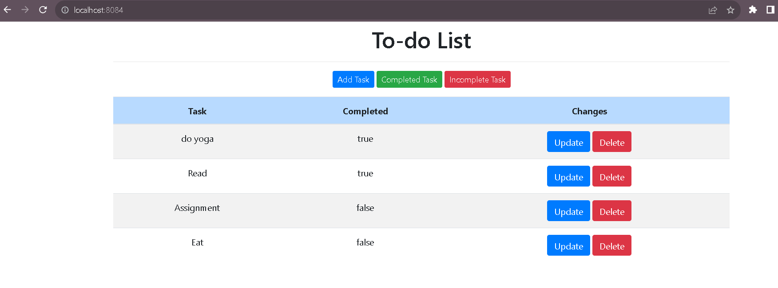
Frontend

Slide 6
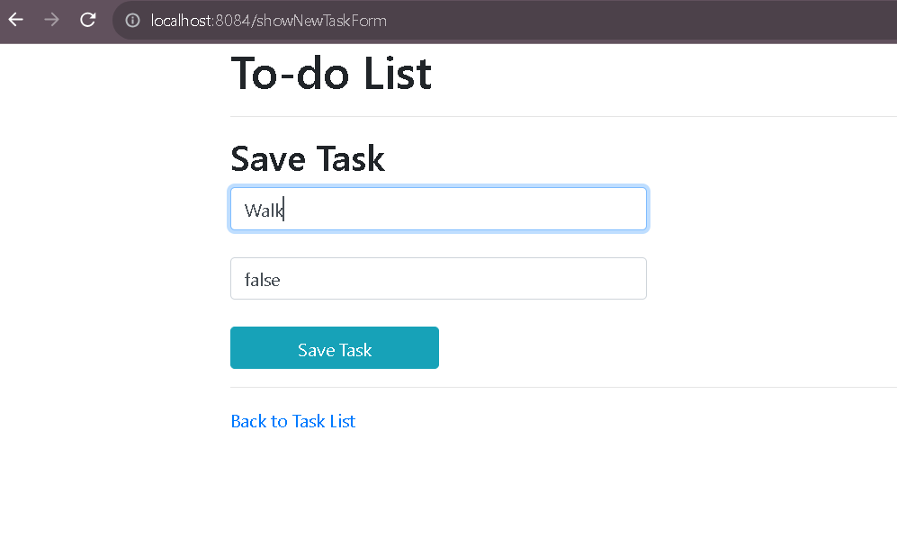
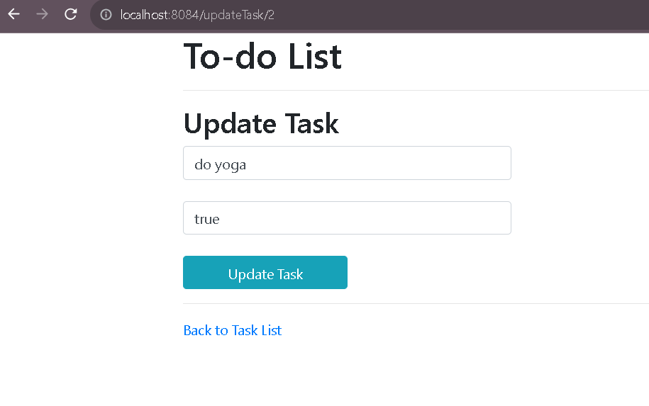

Slide 7
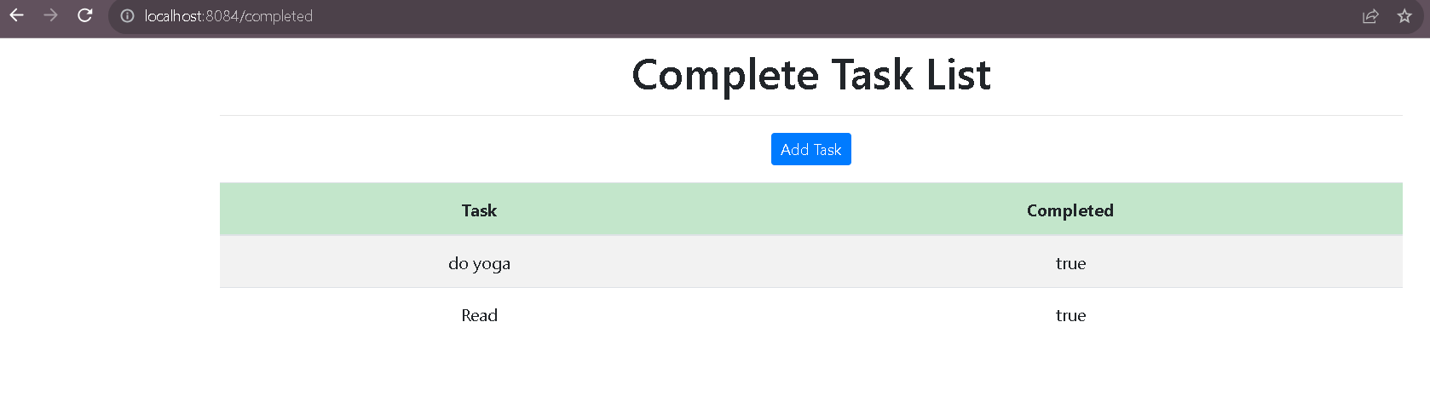
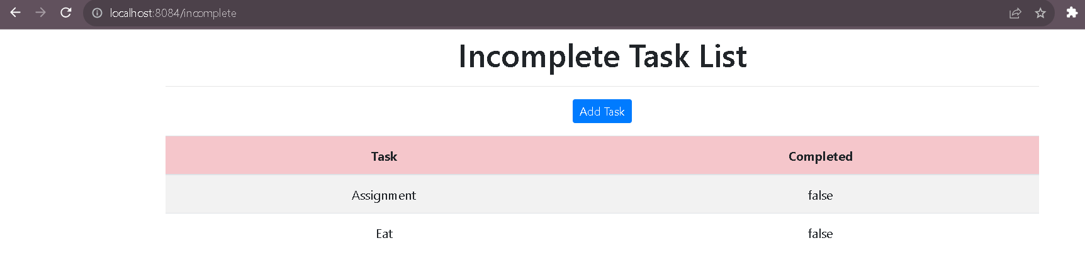

Slide 8
Software Requirement
Software Requirements
Operating System : Windows 11
Language : Java, Html, CSS, Bootstrap
IDE : Spring Tool Suite
Client : Postman/Browser
Backend : MySQL
Frontend: Thymeleaf
Hardware Requirements
CPU : Intel i3 processor
RAM : 4 GB or above
Hard Disk : 1TB hard disk space or minimum

Slide 9
Conclusion
Todo List Management System is created to organize your daily task in a simple way. There is a space for further development with regards to adding more features. One of the key challenges is to chose appropriate storage solution that will allow to maintain its biggest advantages:
Simplicity
Speed
Low resources demand

Slide 10
Thank You!

